Slide 1
TEAM MICE
PROBLEM
How can we increase the participation of urban and youth voters in elections to ensure their involvement in the democratic process

Slide 2
Brief about the Idea:
Here we use blockchain technology to cast votes by creating a smart contract and deploying it on blockchain
By making use of blockchain technology, Vote can be casted from any where and in highly secure manner.
NRIs’ can cast their vote easily without actually reaching the polling booth.

Slide 3
List of features offered by the solution :
People can cast their vote remotely.
As everything will be transparent final result cant be modified , and it also improves trust on result.
Result can be published as soon the election ends.
It will potentially increase the voters percentage.

Slide 4
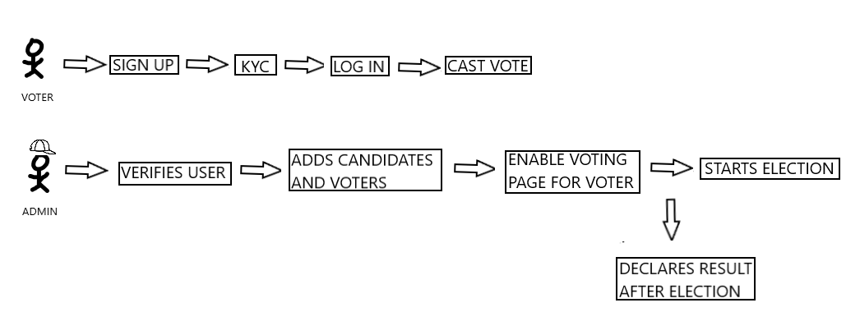
FLOW OR DESIGN

Slide 5
CHALLENGES WE FACED
WE USED WEB3.JS PACKAGE WHICH RESULTED IN MANY ERRORS SO ALTERNATIVELY WE USED REACT WEB3.
OLDER VERSION USED TO FETCH PROVIDER,CONTRACTER AND SIGNER DETAILS FROM WEB3 HAD ISSUES. SO WE HAD TO USE THE UPDATED VERSION.

Slide 6
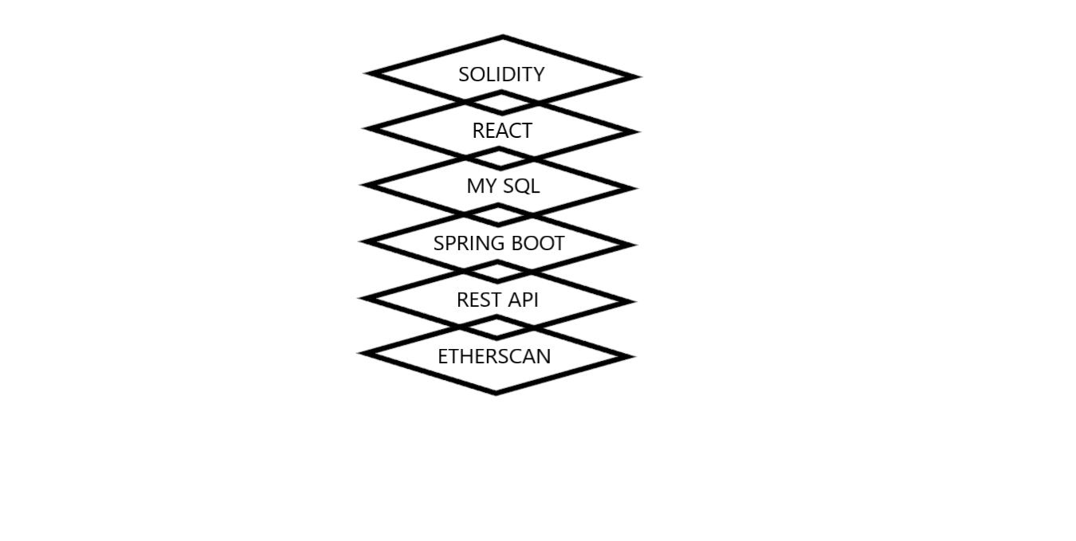
TECHSTACK:
->Truffle

Slide 7


